Slide 1



Noida Institute of Engineering and Technology, Greater Noida
Theory of Automata & Formal Languages
UNIT 1
Unit: 1
TAFL
Yaduvir Singh
Assistant Professor
IT
Course Details
(M Tech Int CSE 4th Sem)
Yaduvir Singh MKCS - 402 TAFL Unit Number: 1

Slide 2
Content
Introduction
Theory of computation
Basic Definitions
Deterministic Finite Automata
DFA Examples
Non Deterministic Finite Automata
NDFA Example
Equivalence of DFA and NDFA
Minimization of NDFA
Machines with Output
Dr. Hitesh Singh KCS - 402 TAFL Unit Number: 1
Yaduvir Singh MKCS - 402 TAFL Unit Number: 1

Slide 3
Course Objective
Introduce concepts in automata theory and theory of computation
Identify different formal language classes and their relationships
Design grammars and recognizers for different formal languages
Prove or disprove theorems in automata theory using its properties
Determine the decidability and intractability of computational problems
Dr. Hitesh Singh KCS - 402 TAFL Unit Number: 1
Yaduvir Singh MKCS - 402 TAFL Unit Number: 1

Slide 4
Course Outcome
Theory of Automata and Formal Languages (KCS-402)
Course Outcome (CO) |  | Bloom’s Knowledge Level (KL)
At the end of the course, the student will be able to understand
CO 1 | Analyze and design finite automata, pushdown automata, Turing machines, formal languages and grammars. |  | K4, K6
CO 2 | Analyze and design, Turing Machine, formal languages and grammars. |  | K4, K6
CO 3 | Demonstrate the understanding of key notions, such as algorithms, computability, decidability and complexity through problem solving. |  | K1, K5
CO 4 | Prove the basic result of the Theory of Computation. |  | K2, K3
CO 5 | State and explain the relevance of the Church Turing Thesis. |  | K1, K5
Yaduvir Singh MKCS - 402 TAFL Unit Number: 1

Slide 5
CO-PO and PSO Mapping
CO-PO correlation matrix of Theory of Automata and Formal Languages (KCS 402)
 | PO1 | PO2 | PO3 | PO4 | PO5 | PO6 | PO7 | PO8 | PO9 | PO10 | PO11 | PO12
MKCS402.1 | 2 | 2 | 3 | 3 | 2 | 2 | - | - | 2 | 1 | - | 3
MKCS402.2 | 1 | 3 | 2 | 3 | 2 | 2 | - | 1 | 1 | 1 | 2 | 2
MKCS402.3 | 2 | 2 | 3 | 2 | 2 | 2 | - | 2 | 2 | 1 | 2 | 3
MKCS402.4 | 2 | 2 | 2 | 3 | 2 | 2 | - | 2 | 2 | 1 | 1 | 3
MKCS402.5 | 3 | 2 | 2 | 2 | 2 | 2 | - | 2 | 1 | 1 | 1 | 2
Average | 2 | 2.2 | 2.4 | 2.6 | 2 | 2 | - | 1.4 | 1.6 | 1 | 1.2 | 2.6
Mapping of Program Specific Outcomes and Course Outcomes:
Course Outcomes | Program Specific Outcomes
 | PSO1 | PSO2 | PSO3 | PSO4
MKCS402.1 | 2 | 2 | 2 | 2
MKCS402.2 | 2 | 2 | 1 | 1
MKCS402.3 | 2 | 2 | 1 | 1
MKCS402.4 | 2 | 2 | 1 | 1
MKCS402.5 | 2 | 2 | 2 | 2
Average | 2 | 2 | 1.4 | 1.4
Yaduvir Singh MKCS - 402 TAFL Unit Number: 1

Slide 6
Unit Objective
To understand the designing of Deterministic Finite Automata.
To understand the designing of Non deterministic finite automata.
To understand the Minimization of Finite Automata.
To understand the designing the Finite automata with output.
Yaduvir Singh MKCS - 402 TAFL Unit Number: 1

Slide 7
Prerequisite and Recap
Brief review of different operations like Union, Intersection, difference, Complement, Introduction of graph & concept of equivalence relation & equivalence class.
Yaduvir Singh MKCS - 402 TAFL Unit Number: 1

Slide 8
Unit I Syllabus
Basic Concepts and Automata Theory: Introduction to Theory of Computation- Automata, Computability and Complexity, Alphabet, Symbol, String, Formal Languages, Deterministic Finite Automaton (DFA)- Definition, Representation, Acceptability of a String and Language, Non Deterministic Finite Automaton (NFA), Equivalence of DFA and NFA, NFA with ε-Transition, Equivalence of NFA’s with and without ε-Transition, Finite Automata with output- Moore Machine, Mealy Machine, Equivalence of Moore and Mealy Machine, Minimization of Finite Automata, Myhill-Nerode Theorem, Simulation of DFA and NFA
Yaduvir Singh MKCS - 402 TAFL Unit Number: 1

Slide 9
Theory of Computation (CO1)
Prerequisite: Brief review of different operations like Union, Intersection, difference, Complement, Introduction of graph & concept of equivalence relation & equivalence class
Objective: To understand the basic definition of Automata
Yaduvir Singh MKCS - 402 TAFL Unit Number: 1

Slide 10
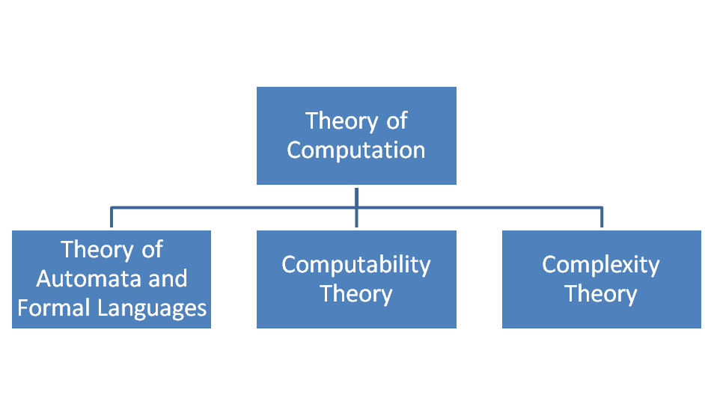
Theory of Computation (CO1)
Objective: To understand the basic definition of Automata
It is a branch of computer science that deals with how effectively a problem can be solved on a model of computation by using an algorithm.
Yaduvir Singh MKCS - 402 TAFL Unit Number: 1

Slide 11
Theory of Computation (CO1)
Objective: To understand the basic definition of Automata
Theory of Automata and Formal Languages :
It deals with the definition and properties of various mathematical models of computer.
Example : Finite Automat, Context Free Grammar, PDA, Turing Machine
Computability Theory:
It deals with what can and what cannot be computed by model.
Complexity Theory:
It deals with computable problems based on their hardness.
Purpose of TOC:
In order to develop formal mathematical model of computations that reflect real world computers.
Yaduvir Singh MKCS - 402 TAFL Unit Number: 1

Slide 12
Basic Definitions:
Symbol:
It is a character.
For Example : a,b,c,…….z
0,1,2,3,4…9
+,-,%,&........ Special characters.
Alphabet:
An alphabet is defined as a finite non empty set of symbols. It is representd by symbol : Σ
Example: Σ: {0,1} set of binary alphabets.
Σ: {a,b,c,……z} set of all lower case letters.
Σ: {+,-,*,/,……} set of all special characters.
Yaduvir Singh MKCS - 402 TAFL Unit Number: 1

Slide 13
Basic Definitions…
String
Definition − A string is a finite sequence of symbols taken from ∑.
Example − ‘cabcad’ is a valid string on the alphabet set ∑ = {a, b, c, d}
Length of a String
Definition − It is the number of symbols present in a string. (Denoted by |S|).
Examples −
  If S = ‘cabcad’, |S|= 6
  If |S|= 0, it is called an empty string (Denoted by λ or ε)
Yaduvir Singh MKCS - 402 TAFL Unit Number: 1

Slide 14
Basic Definitions…
Kleene Star
Definition − The Kleene star, ∑*, is a unary operator on a set of symbols or strings, ∑, that gives the infinite set of all possible strings of all possible lengths over ∑ including λ.
Representation − ∑* = ∑₀ ∪ ∑₁ ∪ ∑₂ ∪……. where ∑_{p} is the set of all possible strings of length p.
Example − If ∑ = {a, b}, ∑* = {λ, a, b, aa, ab, ba, bb,………..}
Kleene Closure / Plus
Definition − The set ∑⁺ is the infinite set of all possible strings of all possible lengths over ∑ excluding λ.
Representation − ∑⁺ = ∑₁ ∪ ∑₂ ∪ ∑₃ ∪…….
∑⁺ = ∑* − { λ }
Example − If ∑ = { a, b } , ∑⁺ = { a, b, aa, ab, ba, bb,………..}
Yaduvir Singh MKCS - 402 TAFL Unit Number: 1

Slide 15
Basic Definitions (Continued)
Language
Definition − A language is a subset of ∑* for some alphabet ∑. It can be finite or infinite.
Example − If the language takes all possible strings of length 2 over ∑ = {a, b}, then L = { ab, aa, ba, bb }
Yaduvir Singh MKCS - 402 TAFL Unit Number: 1

Slide 16
Automata
An automaton with a finite number of states is called a Finite Automaton (FA) or Finite State Machine (FSM).
Formal definition of a Finite Automaton
An automaton can be represented by a 5-tuple (Q, ∑, δ, q₀, F), where −
Q is a finite set of states.
∑ is a finite set of symbols, called the alphabet of the automaton.
δ is the transition function.
q₀ is the initial state from where any input is processed (q₀ ∈ Q).
F is a set of final state/states of Q (F ⊆ Q).
Yaduvir Singh MKCS - 402 TAFL Unit Number: 1

Slide 17
Deterministic Finite Automaton (DFA)
Recap: In previous slides we have learned about basic definitions used in Automata.
Prerequisite: Knowledge about Alphabet, string and language.
Objective: To understand the formal mathematical definition of DFA
Yaduvir Singh MKCS - 402 TAFL Unit Number: 1

Slide 18
Deterministic Finite Automaton (DFA)
Objective: To understand the formal mathematical definition of DFA
Formal Definition of a DFA
A DFA can be represented by a 5-tuple (Q, ∑, δ, q₀, F) where −
Q is a finite set of states.
∑ is a finite set of symbols called the alphabet.
δ is the transition function where δ: Q × ∑ → Q
q₀ is the initial state from where any input is processed (q₀ ∈ Q).
F is a set of final state/states of Q (F ⊆ Q).
Yaduvir Singh MKCS - 402 TAFL Unit Number: 1

Slide 19
Graphical Representation of a DFA (CO1)
A DFA is represented by digraphs called state diagram.
The vertices represent the states.
The arcs labeled with an input alphabet show the transitions.
The initial state is denoted by an empty single incoming arc.
The final state is indicated by double circles.
Example
Let a deterministic finite automaton be →
Q = {a, b, c},
∑ = {0, 1},
q₀ = {a},
F = {c},
Yaduvir Singh MKCS - 402 TAFL Unit Number: 1

Slide 20
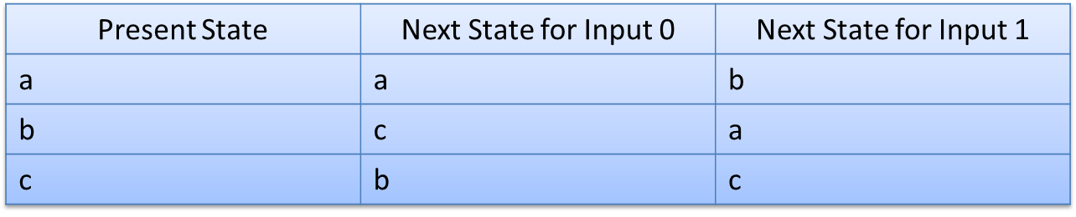
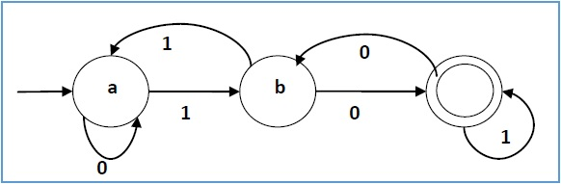
Graphical Representation of a DFA
Its graphical representation would be as follows −
Yaduvir Singh MKCS - 402 TAFL Unit Number: 1

Slide 21
DFA - Examples
1. Design a DFA that accepts “a”, over an alphabet ∑={a}
q0
a
q1
Yaduvir Singh MKCS - 402 TAFL Unit Number: 1

Slide 22
DFA - Examples
2. Design a DFA that accepts 0 or more ‘a’
a
q0
Yaduvir Singh MKCS - 402 TAFL Unit Number: 1

Slide 23
DFA - Examples
3. Design a DFA over an alphabet ∑={a}, which accepts those strings which starts with 1 and ends with 0.
1
0
q0
1
q1
0
q2
1
Yaduvir Singh MKCS - 402 TAFL Unit Number: 1

Slide 24
DFA - Examples
4. Draw a DFA for following language over an alphabet {a,b}, L={all strings starting with abb}
a , b
q0
a
q1
b
q2
b
q3
Yaduvir Singh MKCS - 402 TAFL Unit Number: 1

Slide 25
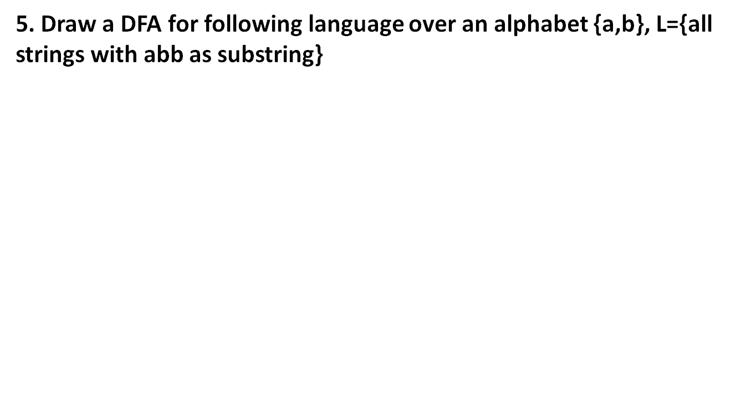
DFA - Examples
b
a
a , b
q0
a
q1
b
q2
b
q3
a
Yaduvir Singh MKCS - 402 TAFL Unit Number: 1

Slide 26
DFA - Examples
6. Draw a DFA for following language over an alphabet {a,b}, L={all strings ending with abb}
b
b
a
a
a , b
q0
a
q1
b
q2
b
q3
a
Yaduvir Singh MKCS - 402 TAFL Unit Number: 1

Slide 27
DFA - Examples
7. Design a DFA over an alphabet {a,b} such that every string accepted must be of length:
|w|=2(mod3)
R=0
q0
a,b
q1
R=1
a,b
a,b
q2
R=2
Yaduvir Singh MKCS - 402 TAFL Unit Number: 1

Slide 28
Non – Deterministic Finite Automata (CO1)
Recap: Learn the designing of DFA
Prerequisite: Understanding of DFA
Objective: To understand the mathematical definition of NDFA
Yaduvir Singh MKCS - 402 TAFL Unit Number: 1

Slide 29
Non – Deterministic Finite Automata (CO1)
Objective: To understand the mathematical definition of NDFA
Formal Definition of an NDFA
An NDFA can be represented by a 5-tuple (Q, ∑, δ, q₀, F) where −
Q is a finite set of states.
∑ is a finite set of symbols called the alphabets.
δ is the transition function where δ: Q × ∑ → 2^{Q}
(Here the power set of Q (2^{Q}) has been taken because in case of
NDFA, from a state, transition can occur to any combination of Q
states)
q₀ is the initial state from where any input is processed (q₀ ∈ Q).
F is a set of final state/states of Q (F ⊆ Q).
Yaduvir Singh MKCS - 402 TAFL Unit Number: 1

Slide 30
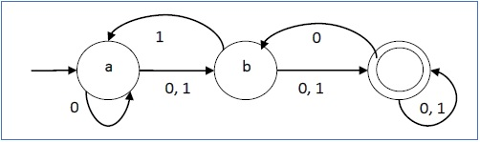
Non – Deterministic Finite Automata
An NDFA is represented by digraphs called state diagram.
The vertices represent the states.
The arcs labeled with an input alphabet show the transitions.
The initial state is denoted by an empty single incoming arc.
The final state is indicated by double circles.
Yaduvir Singh MKCS - 402 TAFL Unit Number: 1

Slide 31
NDFA – EXAMPLE
1. Draw a NDFA to accept strings containing the substring 0101
0,1
0,1
0
q1
1
0
1
q4
q0
q2
q3
Yaduvir Singh MKCS - 402 TAFL Unit Number: 1

Slide 32
Quiz Link 16 april 2021 TAFL Quiz1
https://forms.office.com/Pages/ResponsePage.aspx?id=Qzw2YSCEykOPgoAWJ-Fs3zESUndhQMZKp6OosChgoi9UOE9XQ1FOUlNaTzFJQlNZMUE4VUtNQUlEVy4u
Yaduvir Singh MKCS - 402 TAFL Unit Number: 1

Slide 33
THE EQUIVALENCE OF DFA AND NDFA
Construct a DFA equivalent of following NDFA:
δ/Σ | a | b
→q0 | q0,q1 | q0
q1 | q2 | q1
q2 | q3 | q3
*q3 |  | q2
δ/Σ | a | b
[→q0] | [q0,q1] | [q0]
[q0,q1] | [q0,q1,q2] | [q0,q1]
[q0,q1,q2] | *[q0,q1,q2,q3] | *[q0,q1,q3]
*[q0,q1,q3] | [q0,q1,q2] | [q0,q1,q2]
*[q0,q1,q2,q3] | *[q0,q1,q2,q3] | *[q0,q1,q2,q3]
Yaduvir Singh MKCS - 402 TAFL Unit Number: 1

Slide 34
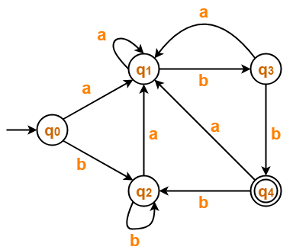
MINIMIZATION OF DFA (CO1)
Minimize the given DFA-
Yaduvir Singh MKCS - 402 TAFL Unit Number: 1

Slide 35
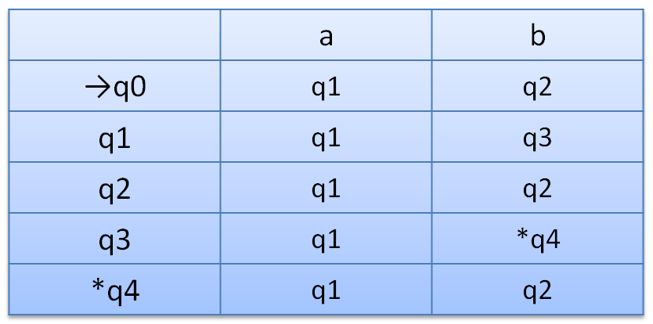
MINIMIZATION OF DFA
Solution-
Step-01:
The given DFA contains no dead states and inaccessible states.
Step-02:
Draw a state transition table-
Yaduvir Singh MKCS - 402 TAFL Unit Number: 1

Slide 36
MINIMIZATION OF DFA
Step-03:
Now using Equivalence Theorem, we have-
P₀ = { q₀ , q₁ , q₂ , q₃ } { q₄ }
P₁ = { q₀ , q₁ , q₂ } { q₃ } { q₄ }
P₂ = { q₀ , q₂ } { q₁ } { q₃ } { q₄ }
P₃ = { q₀ , q₂ } { q₁ } { q₃ } { q₄ }
Since P₃ = P₂, so we stop.
From P₃, we infer that states q₀ and q₂ are equivalent and can be merged together.
So, Our minimal DFA is
Yaduvir Singh MKCS - 402 TAFL Unit Number: 1

Slide 37
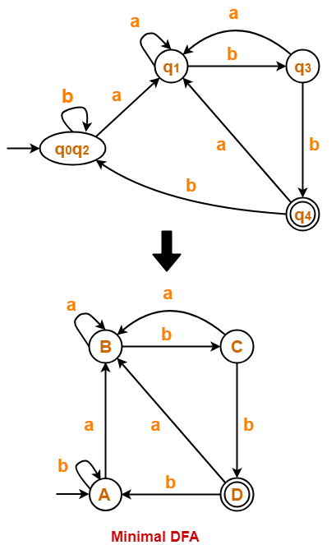
MINIMIZATION OF DFA (CO1)
So after minimization the final DFA will be Like:
Initial DFA
Final DFA
Yaduvir Singh MKCS - 402 TAFL Unit Number: 1

Slide 38
Finite Automata with Outputs (CO1)
Recap: Learn about DFA, NDFA and their designing, and minimization and interconversions.
Prerequisite: Knowledge about DFA, NDFA .
Objective: To understand the Finite Automata Machines which gives output.
Yaduvir Singh MKCS - 402 TAFL Unit Number: 1

Slide 39
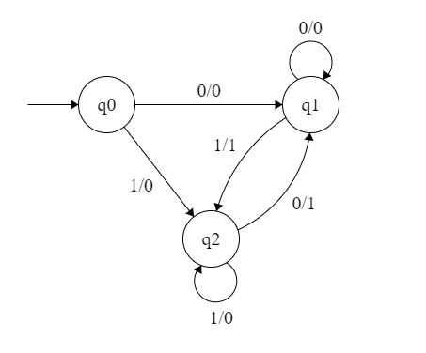
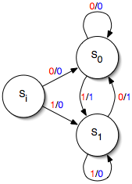
Finite Automata with Outputs (CO1)
Moore Machine
It is consists of 6 Touples
Q-Finite set of states
Σ-i/p alphabet
δ-Transition Function
(λ : Q×Σ→Q)
q0-initial state
∆-o/p alphabet
λ-o/p function
Mealy Machine
It is consists of 6 Touples
Q-Finite set of states
Σ-i/p alphabet
δ-Transition Function
(λ :Q×Σ→ ∆)
q0-initial state
∆-o/p alphabet
λ -o/p function
Yaduvir Singh MKCS - 402 TAFL Unit Number: 1

Slide 40
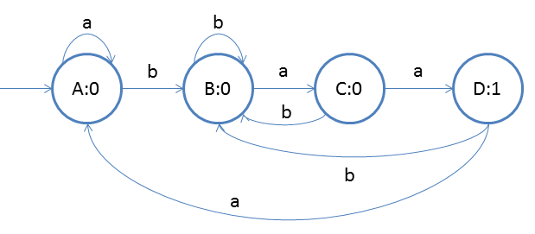
Moore machine
Construct a Moore machine that takes set of all strings over alphabet {a,b} as i/p and prints 1 as o/p for every string ending with ‘baa’ as substring.
Yaduvir Singh MKCS - 402 TAFL Unit Number: 1

Slide 41
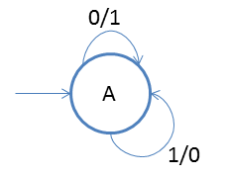
Mealy Machine
Construct a Mealy machine for 1’s compliment
Yaduvir Singh MKCS - 402 TAFL Unit Number: 1

Slide 42
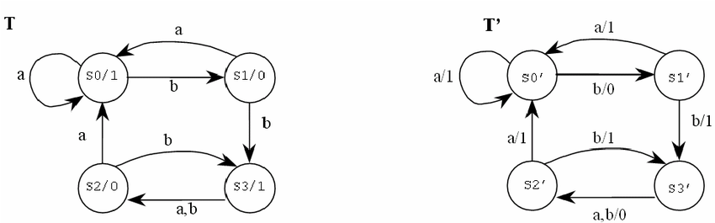
Moore to Mealy conversion
Given Moore Machine
Mealy Machine after conversion
Link: https://www.youtube.com/watch?v=RBDE-vO7Ux0
Yaduvir Singh MKCS - 402 TAFL Unit Number: 1

Slide 43
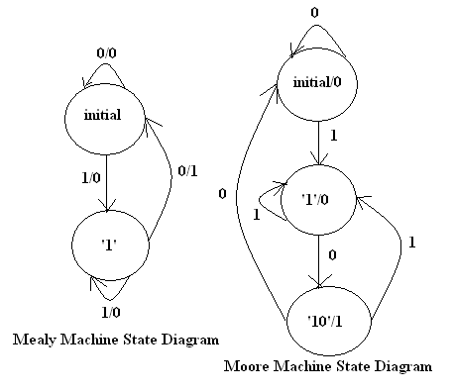
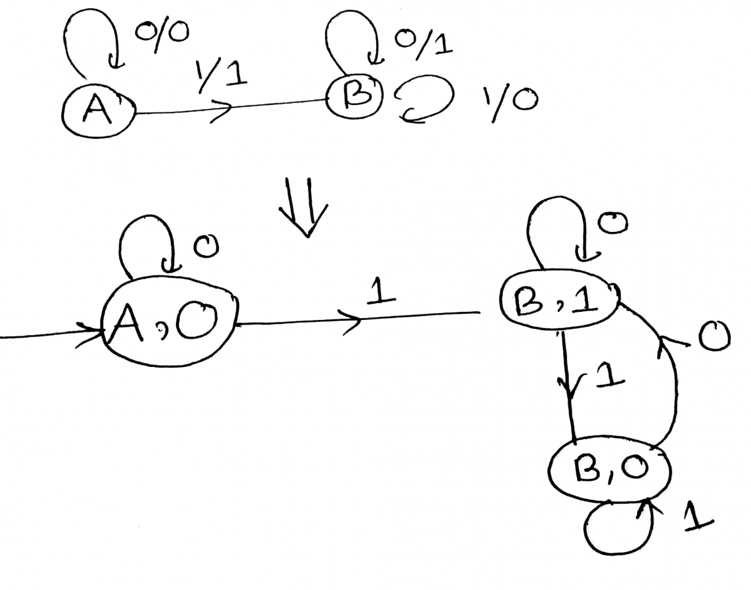
Mealy to Moore Conversion
Given Mealy Machine
Given Mealy Machine
Moore Machine after Conversion
Moore Machine after Conversion
Link: https://www.youtube.com/watch?v=vcNRb2cj1GI
Yaduvir Singh MKCS - 402 TAFL Unit Number: 1

Slide 44
Faculty Video Links, Youtube & NPTEL Video Links and Online Courses Details
Youtube/other Video Links
https://www.youtube.com/watch?v=Hl5jNAXcW18
https://www.youtube.com/watch?v=-aIRqNnUvEg&list=PL85CF9F4A047C7BF7
Yaduvir Singh MKCS - 402 TAFL Unit Number: 1

Slide 45
Daily Quiz
Draw a DFA for the following language over {0,1}:
  All strings with even number of 0 and even number of 1.
  All string of length at most 5.
Prove that NDFA = DFA
Give DFA accepting the following language over alphabet {0,1}
  The set of all strings ending in 00
  The ste of strings with 011 as sub string.
  The set of string starting with 10.
What do you understand by Epsilon closure in FA?
State and prove Myhill Nerode Theorem.
Construct a DFA for the language that contains the strings ending with 0.
Yaduvir Singh MKCS - 402 TAFL Unit Number: 1

Slide 46
Weekly Assignment
https://drive.google.com/file/d/13kK3291TzguwU6GAA8vIqrRw6w_13ypj/view?usp=sharing
Yaduvir Singh MKCS - 402 TAFL Unit Number: 1

Slide 47
MCQ s
The non- Kleene Star operation accepts the following string of finite length over set A = {a,b} | where string s contains even number of 0 and 1
  ab,aabb,ababab
  aabb,bbaabbaa
  ε,aabb,bbaabbaa
  ε,aabb,bbaabbaa
A regular language over an alphabet ∑ is one that cannot be obtained from the basic languages using the operation
  Union
  Concatenation
  Kleene*
  All of the mentioned
Yaduvir Singh MKCS - 402 TAFL Unit Number: 1

Slide 48
MCQ s
Which of the following is a not a part of 5-tuple finite automata?
  Input alphabet
  Transition function
  Initial State
  Output Alphabet
Moore Machine is an application of:
  a. Finite automata without input
  b. Finite automata with output
  c. Non- Finite automata with output
  d. None of the mentioned
Yaduvir Singh MKCS - 402 TAFL Unit Number: 1

Slide 49
Old Question Papers
https://drive.google.com/file/d/12YgCV_q7QeE1d_Hp0JrOWRFgXOcdKSRc/view?usp=sharing
https://drive.google.com/file/d/1J5wqcdUF3nf_8UMcYD_wTblTK3SmChqr/view?usp=sharing
https://drive.google.com/file/d/1VxIo8y0ZSdXXcHYLwUgii9MuZEosGGyC/view?usp=sharing
https://drive.google.com/file/d/1ZlOKf6Il9xwPF6YlmSGAsFSsAjT4fNPu/view?usp=sharing
https://drive.google.com/file/d/1dyqbDpBPuY50gsmu62JcVtgD65t_0lu4/view?usp=sharing
Yaduvir Singh MKCS - 402 TAFL Unit Number: 1

Slide 50
Expected Questions for University Exam
Design a DFA over an alphabet {0,1}, which accepts those strings which starts with 1 and ends with 0.
Design a DFA over an alphabet {0,1}, which accepts those stings which contain odd number of 1’s.
Design a DFA over an alphabet {0,1}, which accepts those stings of length at most 5.
Design a DFA for a language of strings for an alphabet {0,1}, which accepts a string ending with 10.
Design a DFA for the language containing strings in which left most symbol differ from right most symbol over an alphabet {0,1}.
Yaduvir Singh MKCS - 402 TAFL Unit Number: 1

Slide 51
Summary
The knowledge of regular languages and finite automata is essential for designing a compiler.
Deterministic Finite Automata are machine model which recognize strings of a regular language.
All type of Finite Automata (DFA, NDFA ) are equal in power and convert one type of automata to other.
Yaduvir Singh MKCS - 402 TAFL Unit Number: 1

Slide 52
References
Aho, Hopcroft and Ullman, The Design and Analysis of Computer Algorithms, Addison Wesley.
Aho, Sethi, Ullman, Compilers Principles, Techniques and Tools, Pearson Education, 2003.
Hopcroft and Ullman, Introduction to Automata Theory, Languages and Computation, Addison Wesley.
Kohavi, ZVI, Switching And Finite Automata Theory, Tata McGraw-Hill, 2006.
Lewis and Papadimitriou, Elements of the Theory of Computation, Prentice-Hall.
Martin, Introduction to Languages and the Theory of Computation, McGraw-Hill, 2nd edition,1996.
Mishra, KLP, Chandrasekaran, N. Theory of Computer Science, (Automata, Languages and Computation) PHI, 2002.
Yaduvir Singh MKCS - 402 TAFL Unit Number: 1

Slide 53

Noida Institute of Engineering and Technology, Greater Noida
Yaduvir Singh MKCS - 402 TAFL Unit Number: 1

